Slide 1
NARMADHA HOSPITAL
24 HOURS

Slide 2
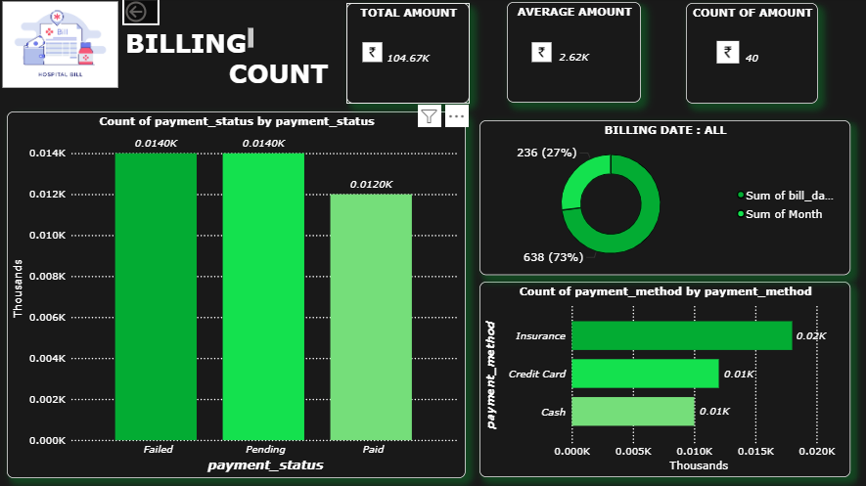
BILLING COUNT DASEBOARD
This dashboard provides insights into hospital billing transactions.
The total billing amount recorded is ₹104.67K, with an average bill value of ₹2.62K across 40 transactions.
Payment status is distributed across Failed (0.014K), Pending (0.014K), and Paid (0.012K) cases.
Analysis of payment methods shows Insurance is the most used, followed by Credit Card and Cash.
Billing distribution by date highlights 73% in one month and 27% in another, reflecting seasonal or operational trends.

Slide 3
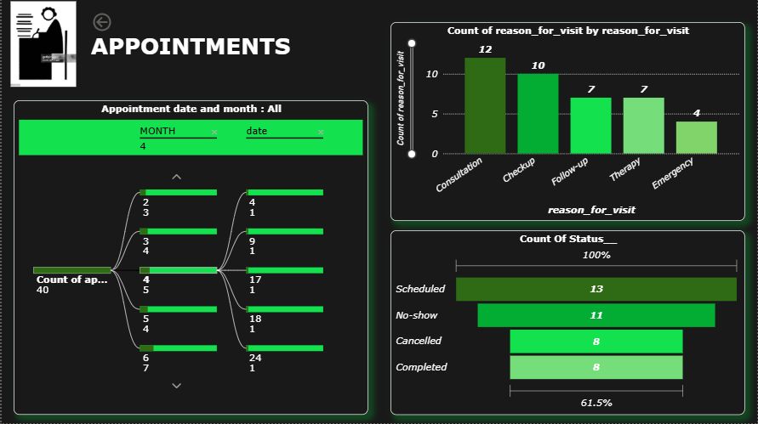
APPOINTMENTS DASHBOARD
This dashboard highlights the hospital’s appointment records.
A total of 40 appointments were logged, spread across multiple dates in the month.
Reasons for visits: Consultation (12), Checkup (10), Follow-up (7), Therapy (7), and Emergency (4).
Appointment status: Scheduled (13), No-show (11), Cancelled (8), and Completed (8).
The high number of no-shows (27%) indicates a key area for operational improvement.

Slide 4
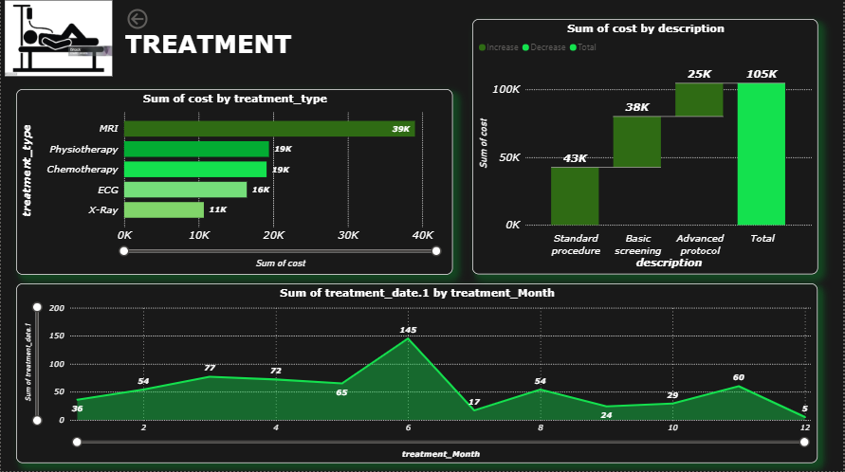
TREATMENT DASHBOARD
This dashboard gives a cost-based overview of different treatment types.
The highest cost is from MRI scans (39K), followed by Physiotherapy (19K), Chemotherapy (19K), ECG (16K), and X-Ray (11K).
Treatment costs by description show Standard procedures (43K), Basic screening (38K), and Advanced protocols (25K), totaling 105K.
Monthly treatment data shows peaks in June (145 cases) and dips in July (17 cases), suggesting seasonal variation.
The overall cost pattern reveals where hospital resources are most utilized.

Slide 5
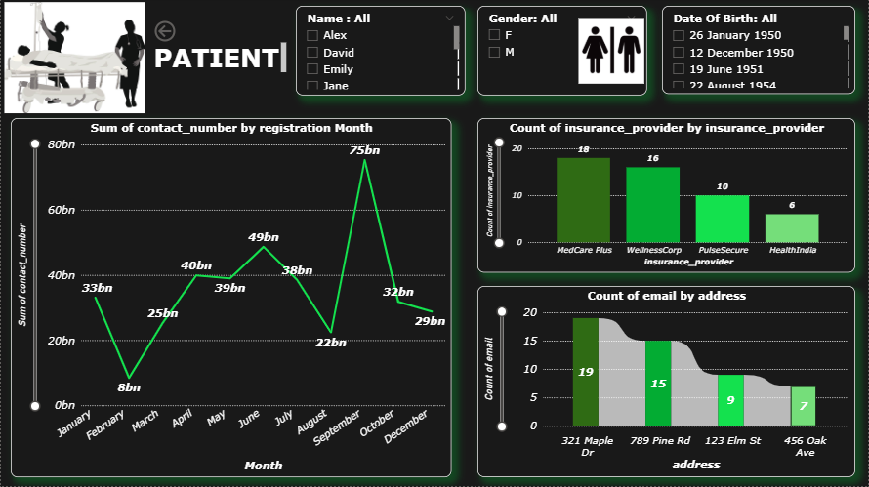
PATIENT DASHBOARD
This dashboard focuses on patient demographics and contact details.
Patient records include names, gender distribution, and date of birth filters.
Contact registration trends vary across months, with a peak of 75bn in September.
Insurance providers: Medicare Plus (18 patients), Wellness Corp (16), Pulse Secure (10), and Health India (6).
Contact information shows top addresses like 321 Maple Dr (19 emails) and 789 Pine Rd (15 emails).
This overview helps in understanding patient engagement and insurance distribution.

Slide 6
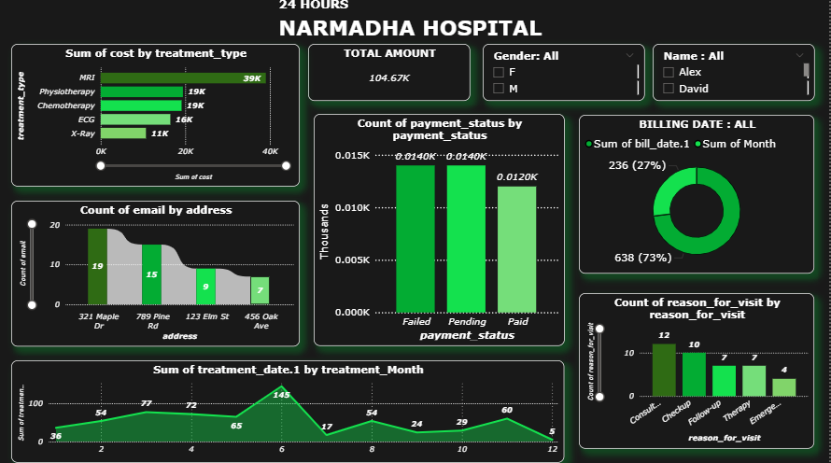
FINAL DASHBOARD
Total Revenue Overview
The hospital generated a total amount of 104.67K within 24 hours.
Gender and patient-wise filters (Alex, David) allow deeper insights.
Treatment Cost Analysis
MRI contributed the highest cost (39K) followed by Physiotherapy and Chemotherapy (each 19K).
ECG and X-Ray contributed 16K and 11K respectively.
Payment Status Insights
Payments were almost evenly distributed across Failed, Pending, and Paid categories (~0.012K each).
Billing Date Distribution
Majority of bills (73%) fall into one category, while the remaining (27%) are spread across other dates.
Patient Communication (Emails by Address)
Highest email activity recorded from 321 Maple Dr (19 emails), followed by 789 Pine Rd (15 emails)
Treatment Trends by Month
Peak treatments occurred in Month 6 (145 treatments) and Month 4 (77 treatments).
Reasons for Visit
Most common reasons were Consultation (12) and Checkups (10).
Other categories included Follow-up (10), Therapy (8), and Emergency (4).

